Slide 1
Dr. Jayaraj P B Associate Professor Department of Computer Science & Engineering, NIT Calicut
Introduction to Artificial Intelligence
1

Slide 2
AI is termed as ‘the new Electricity’
The main goal: To make computers more useful by letting them take over dangerous or tedious tasks from human

Slide 3

What is Artificial Intelligence ?
Artificial intelligence (AI) refers to the simulation of human intelligence in machines that are programmed to make machines to think like humans and mimic their actions.
Or Simply make Machines mimic Human Behavior or Actions

Slide 4
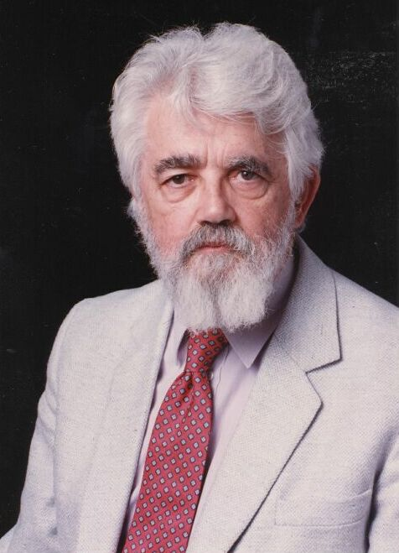
Artificial Intelligence
It is the science and engineering of making intelligent machines, especially intelligent computer programs. (John McCarthy)

Slide 5
History of AI
McCulloch and Pitts (1943)
Neural networks that learn
Minsky (1951)
Built a neural net computer
Dartmouth conference (1956):
McCarthy, Minsky, Newell, Simon
The name “Artficial Intelligence” was coined.
1957 - Perceptron was first used by Frank Rosenblatt
1965 – Multilevel Perceptron (MLP) was invented
1980s - Advanced decision tree and rule learning
1986-present: return to neural networks
Back Propagation algorithm – David E. Rumelhart
1989 – Convolutional Neural Networks (CNN) - Yann LeCun
1990s Ensembles: Bagging, Boosting, and Stacking
2000s - Support vector machines & kernel methods
2007 – GPUs and CUDA frameworks were invented
2010s -Deep learning systems
2012 – Adam Optimizer
2014 – Ian Goodfellow invented the GAN network
2016 – Pascal GPUs (with unified memory) were released
2017 - Transformers

Slide 6
The Birthplace of “Artificial Intelligence”, 1956
Dartmouth workshop, 1956: historical meeting of the perceived founders of AI met: John McCarthy, Marvin Minsky, Alan Newell, and Herbert Simon.
A Proposal for the Dartmouth Summer Research Project on Artificial Intelligence.
"We propose that a 2 month, 10 man study of artificial intelligence be carried out during the summer of 1956 at Dartmouth College in Hanover, New Hampshire. The study is to proceed on the basis of the conjecture that every aspect of learning or any other feature of intelligence can in principle be so precisely described that a machine can be made to simulate it." And this marks the debut of the term "artificial intelligence.“
Notes:
A Proposal for the Dartmouth Summer Research Project on Artificial Intelligence. J. McCarthy, M. L. Minsky, N. Rochester, and C.E. Shannon. August 31, 1955. "We propose that a 2 month, 10 man study of artificial intelligence be carried out during the summer of 1956 at Dartmouth College in Hanover, New Hampshire. The study is to proceed on the basis of the conjecture that every aspect of learning or any other feature of intelligence can in principle be so precisely described that a machine can be made to simulate it." And this marks the debut of the term "artificial intelligence.“

Slide 7
Areas of AI and Some Dependencies
Knowledge Representation
Search
Logic
Machine Learning
Planning
Expert Systems
NLP
Vision
Robotics

Slide 8
What is Learning?
8
Herbert Simon: “Learning is any process by which a system improves performance from experience.”
“A computer program is said to learn from experience E with respect to some class of tasks T and performance measure P, if its performance at tasks in T, as measured by P, improves with experience E.”
– Tom Mitchell
Notes:
8

Slide 9

How Do Children Learn?
- Expose them to lots of data
- Give them the “correct answer”
- They will pick up the important
patterns on their own
Notes:
With children, we expose them to lots of data, and help them learn by supplying the correct answer. A very popular learning technique is “Trail and Error”, where students make a prediction on what is the correct answer, and if they’re wrong, adjust their approach. It turns out that deep learning is very much like this.

Slide 10
What is Machine Learning?
“Learning is any process by which a system improves performance from experience.”
- Herbert Simon
Definition by Tom Mitchell (1998):
Machine Learning is the study of algorithms that
improve their performance P
at some task T
with experience E.
A well-defined learning task is given by <P, T, E>.

Slide 11
Traditional Programming
Data Program
Computer
Output
Machine Learning
Data Output
Computer
Program
4

Slide 12
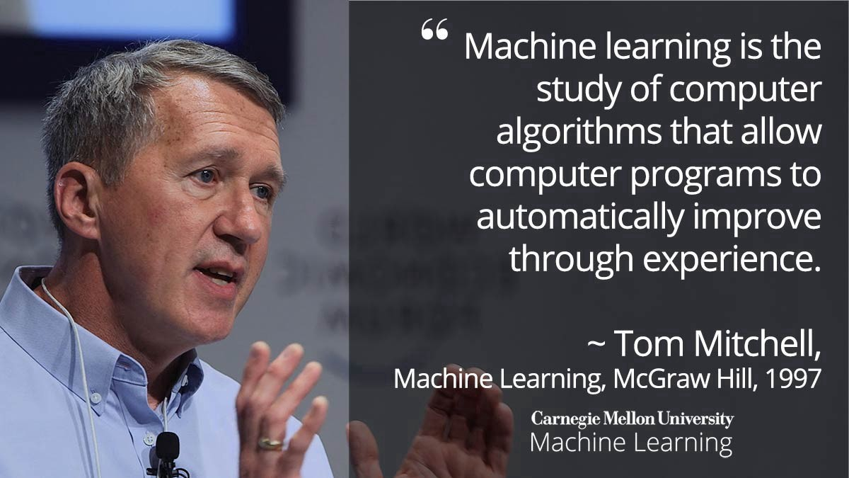
Machine Learning

Slide 13
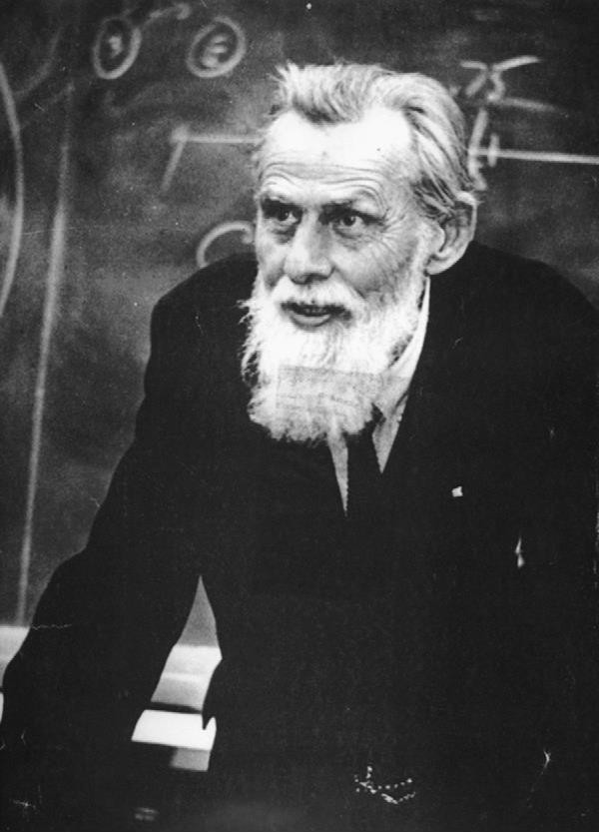
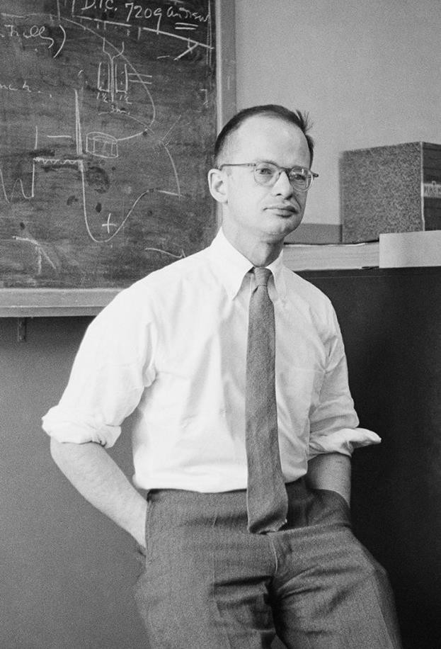
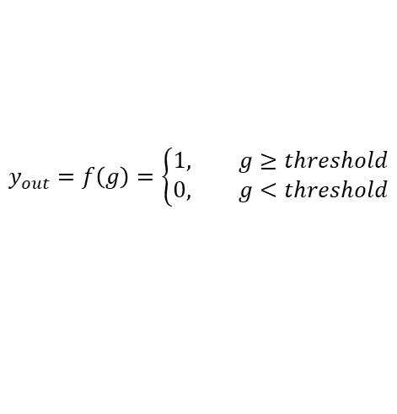



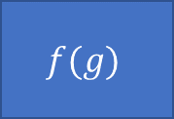
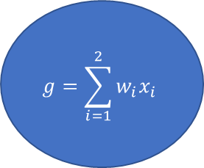
McCulloch-Pitts Neuron (M-P Neuron)
The first computational model of a neuron was proposed by Warren MuCulloch (neuroscientist) and Walter Pitts (mathematician) in 1943.
There are two inputs x₁ and x₂
There is one output y_{out}
All inputs are summed in g
g(x₁, x₂) = x₁ + x₂
Threshold Function or Transfer Function is f that outputs a Boolean value 0 or 1
Output of the neuron y_{out} depends upon the output of the threshold function y_{out} = f(g(x1, x2))
x₁
$$w_{1}$$
$$g=\sum_{i=1}^{2}{w_{i}x_{i}}$$
y_{out}
$$f(g)$$
$$w_{2}$$
x₂
Threshold Function
Summation Function
$$y_{out}=f\left(g\right)=\left\{\begin{aligned}1, g≥threshold \\ &0, g<threshold\end{aligned}\right.$$
$$g={w_{1}x}_{1}+{w_{2}x}_{2}$$

Slide 14
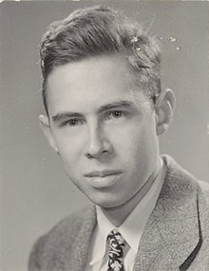
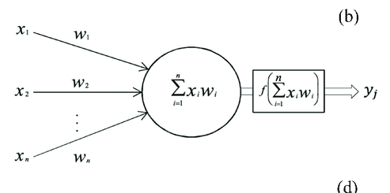
Perceptron by Frank Rosenblatt (1958)
The Perceptron model is similar to M-P Neuron but emphasized that the weights, inputs and outputs can be real valued.
The Perceptron model is essentially a more generalized form of M-P Neuron
The Perceptron also introduced a learning algorithm unlike the M-P Neuron Model
The activation function is Heaviside unit step function

Slide 15
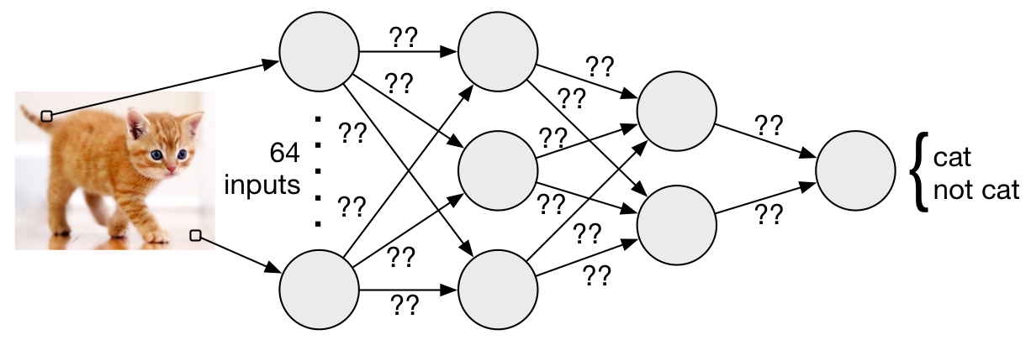
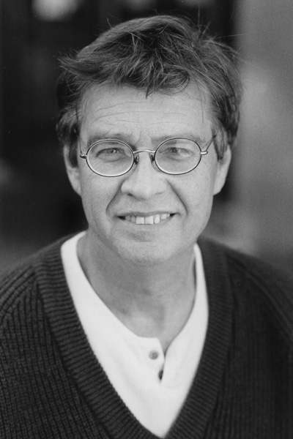
Training Multi-Layer Network – Backpropagation
A multi layer network can be trained by the backpropagation rule (1986, David E. Rumelhart) which is a gradient based algorithm to minimize the errors in both output layer and hidden layer.

Slide 16
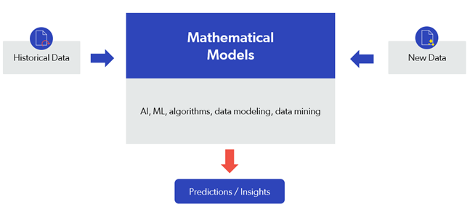
Predictive AI Vs Generative AI
Predictive AI uses statistical algorithms and Machine Learning to forecast trends, behavior, patterns, and predictions from large data sources.

Slide 17
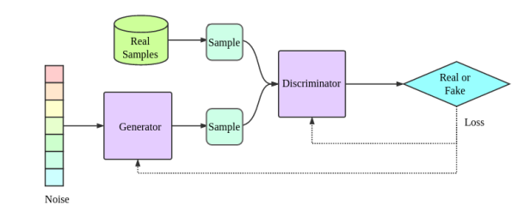
Generative AI
Generative AI is an advanced form of ML that generates new content from scratch. It takes raw data and creates something novel but also recognizable

Slide 18
Supervised vs Unsupervised Machine Learning
When the data we have is labelled and use it to train a ML model it is called supervised machine learning
Examples
Classification Problems
You have 1000s of labelled images of cats and dogs and train a ML model to classify a new image as cat or dog
When the data we have is unlabeled and use it to train a ML model it is called unsupervised machine learning
Examples
Clustering Problems
You have a data of customers and want to segment them into groups but don’t know which criteria to select, a clustering model can help cluster your customers into segments.

Slide 19
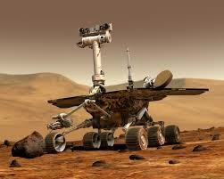
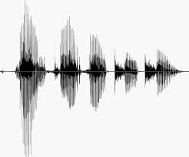
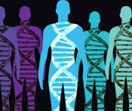
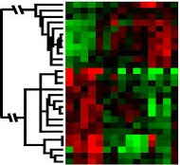
When Do We Use Machine Learning?
ML is used when:
Human expertise does not exist (navigating on Mars)
Humans can’t explain their expertise (speech recognition)
Models must be customized (personalized medicine)
Models are based on huge amounts of data (genomics)
Learning isn’t always useful:
There is no need to “learn” to calculate payroll
Based on slide by E. Alpaydin
5

Slide 20
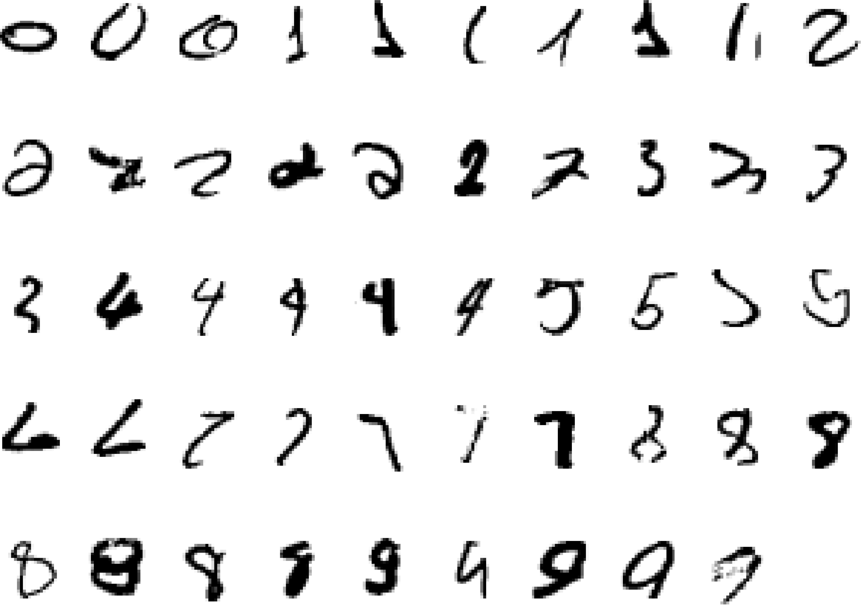
A classic example of a task that requires machine learning: It is very hard to say what makes a 2
6
Slide credit: Geoffrey Hinton

Slide 21
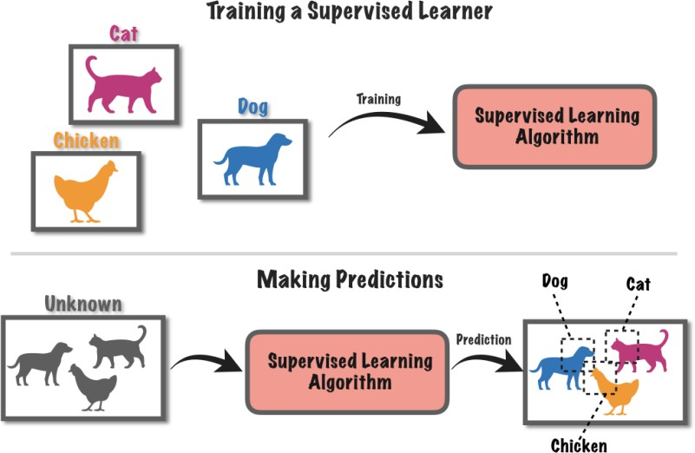
Supervised Learning
Figure: Supervised Learning (Source: TowardsDataScience.com)

Slide 22
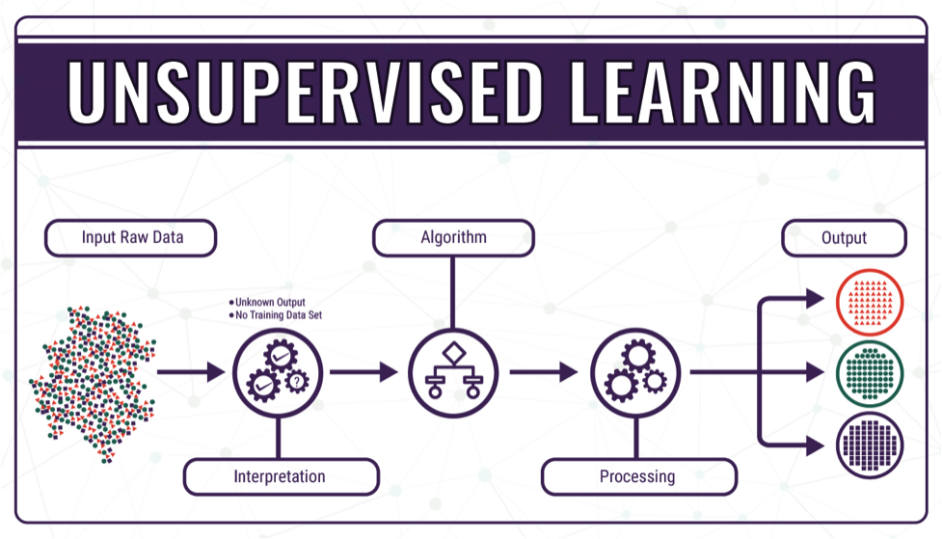
Unsupervised Learning
Figure: Unsupervised Learning

Slide 23
Supervised vs. unsupervised Learning
Supervised learning:
classification is seen as supervised learning from examples.
Supervision: The data (observations, measurements, etc.) are labeled with pre-defined classes. It is like that a “teacher” gives the classes (supervision).
Test data are classified into these classes too.
Unsupervised learning (clustering)
Class labels of the data are unknown
Given a set of data, the task is to establish the existence of classes or clusters in the data

Slide 24
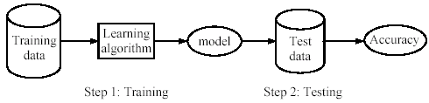
Supervised learning process: two steps
Learning (training): Learn a model using the training data
Testing: Test the model using unseen test data to assess the model accuracy
Data Analytics in Electrical Energy System
7/25/2024
24

Slide 25
What do we mean by learning?
Given
a data set D,
a task T, and
a performance measure M,
a computer system is said to learn from D to perform the task T if after learning the system’s performance on T improves as measured by M.
In other words, the learned model helps the system to perform T better as compared to no learning.

Slide 26
Illustrating Classification Task

Slide 27
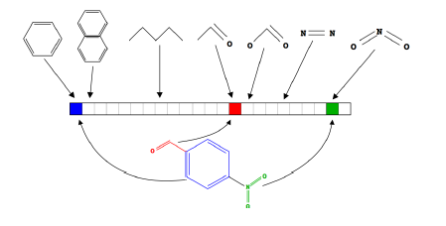
Feature extractions required in ML
Feature Representation
Learning
algorithm
Input
Feature extraction is appearing as a tedious task many time!
Notes:
Where do we get these low-level representations from?

Slide 28
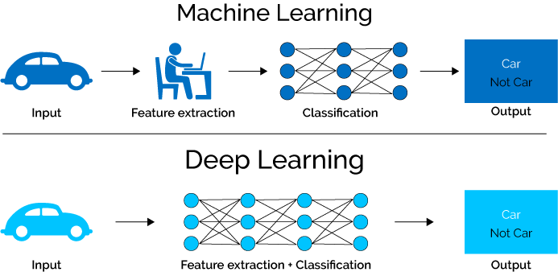
ML vs. Deep Learning
Deep learning (DL) is a machine learning subfield that uses multiple layers for learning data representations
DL is exceptionally effective at learning patterns

Slide 29

Feature Engineering
The problem of transforming raw data into a dataset is called feature engineering.
For most practical problems, feature engineering is a labor-intensive process that demands from the data analyst a lot of creativity and, preferably, domain knowledge

Slide 31
Train – test spliting

Slide 32
Data preparation before using
Understand the type of data in the given input data set.
Explore the data to understand the nature and quality.
Explore the relationships amongst the data elements, e.g. inter-feature relationship.
Find potential issues in data.
Do the necessary remediation, e.g. impute missing data values, etc., if needed.
Apply pre-processing steps, as necessary.
Once the data is prepared for modelling, then the learning tasks start off. Asa part of it, do the following activities:
The input data is first divided into parts – the training data and the test
Consider different models or learning algorithms for selection.
Train the model based on the training data for supervised learning
problem and apply to unknown data. Directly apply the chosen

Slide 33
Sample dataset

Slide 35
A data set is a collection of related information or records.
Data can be broadly divided into following two types
Qualitative data
Quantitative data
Qualitative data provides information about the quality of an object or information which cannot be measured. Qualitative data can be further subdivided into two types as follows:
Nominal data: has named value
Ordinal data: has named value which can be naturally ordered
Quantitative data relates to information about the quantity of an object hence it can be measured. There are two types of quantitative data:
Interval data: numeric data for which the exact difference between values is known. However, such data do not have something called a ‘true zero’ value.
Ratio data: numeric data for which exact value can be measured and absolute zero is available

Slide 36
Explore the data to understand its nature
Measures of central tendency help to understand the central point of a set of data. Standard measures of central tendency of data are mean, median, and mode.
Detailed view of the data spread is available in the form of Dispersion of data:extent of dispersion of a data is measured by variance
Related to the position of the different data values there are five values:minimum, first quartile (Q1), median (Q2), third quartile (Q3), and maximum
Exploration of numerical data can be best done using box plots and histograms.

